Slide 1

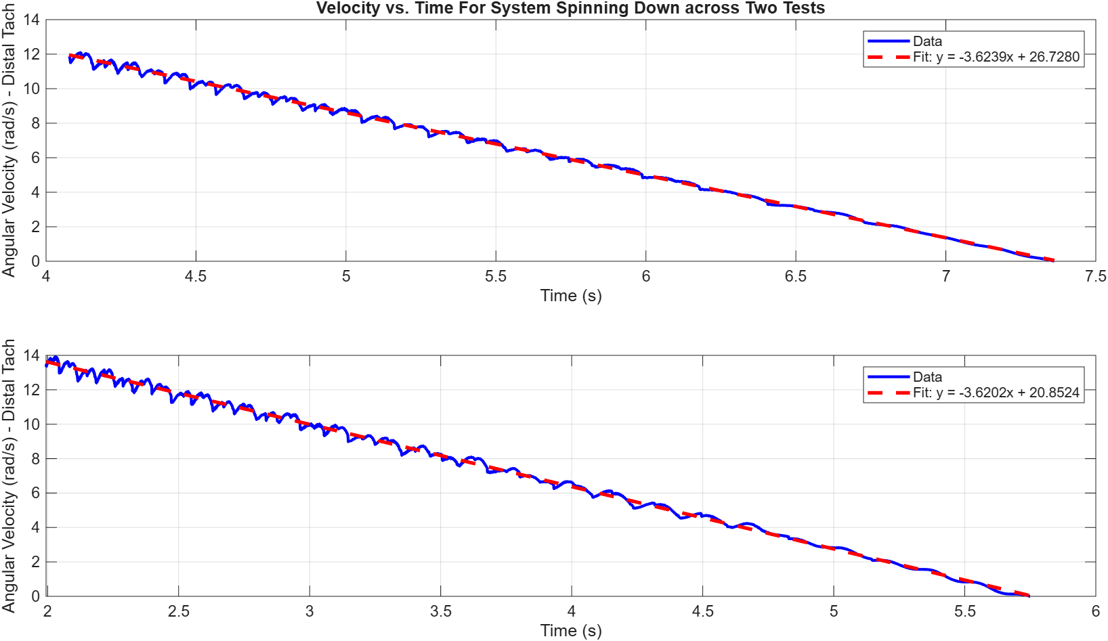
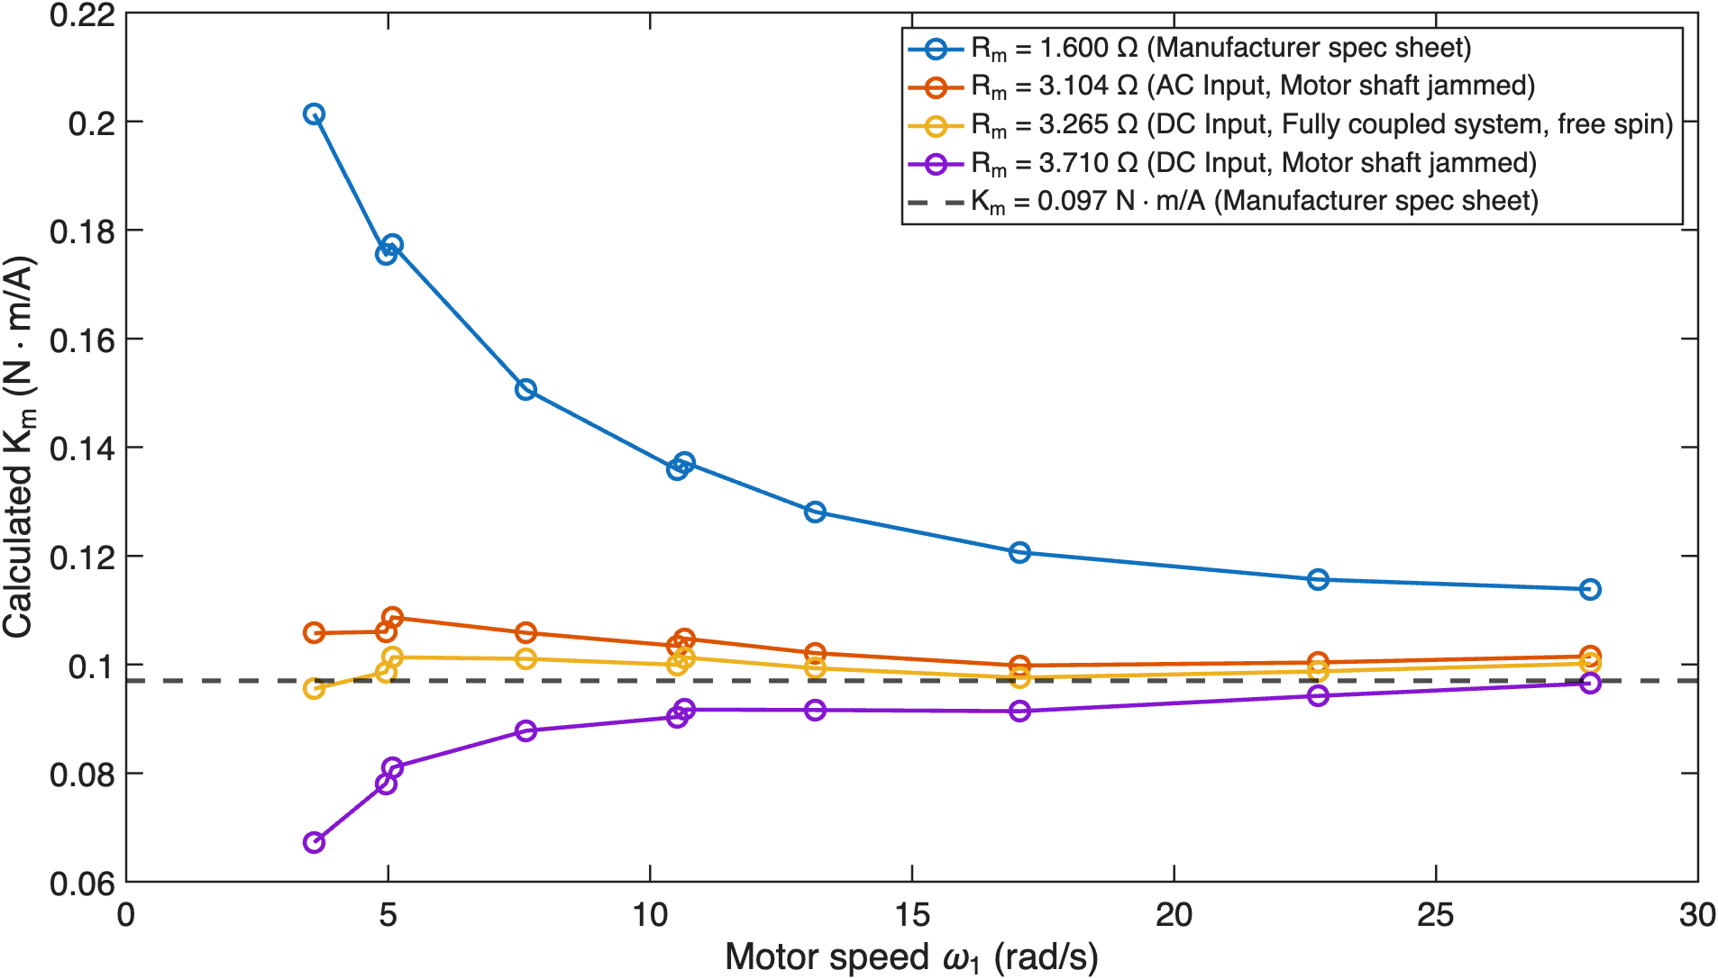
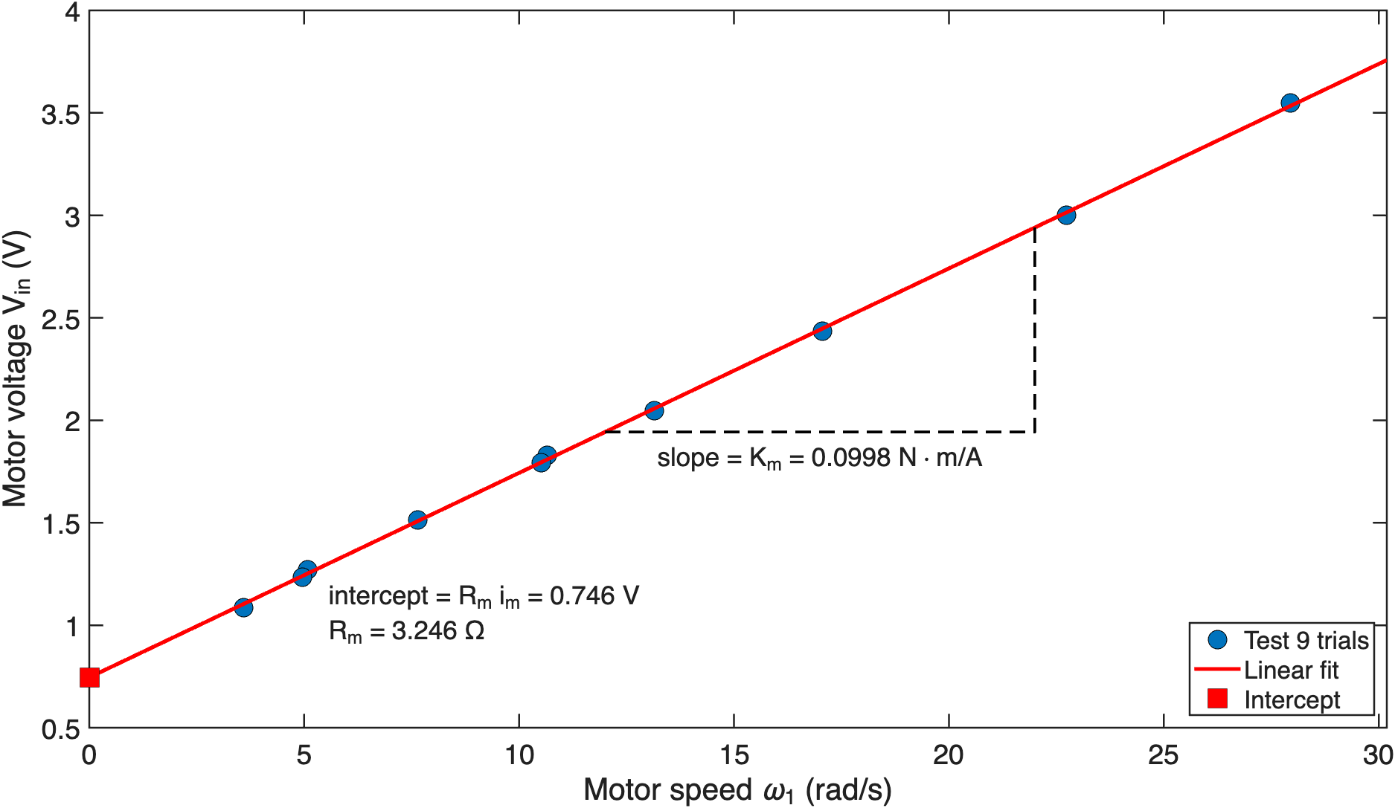
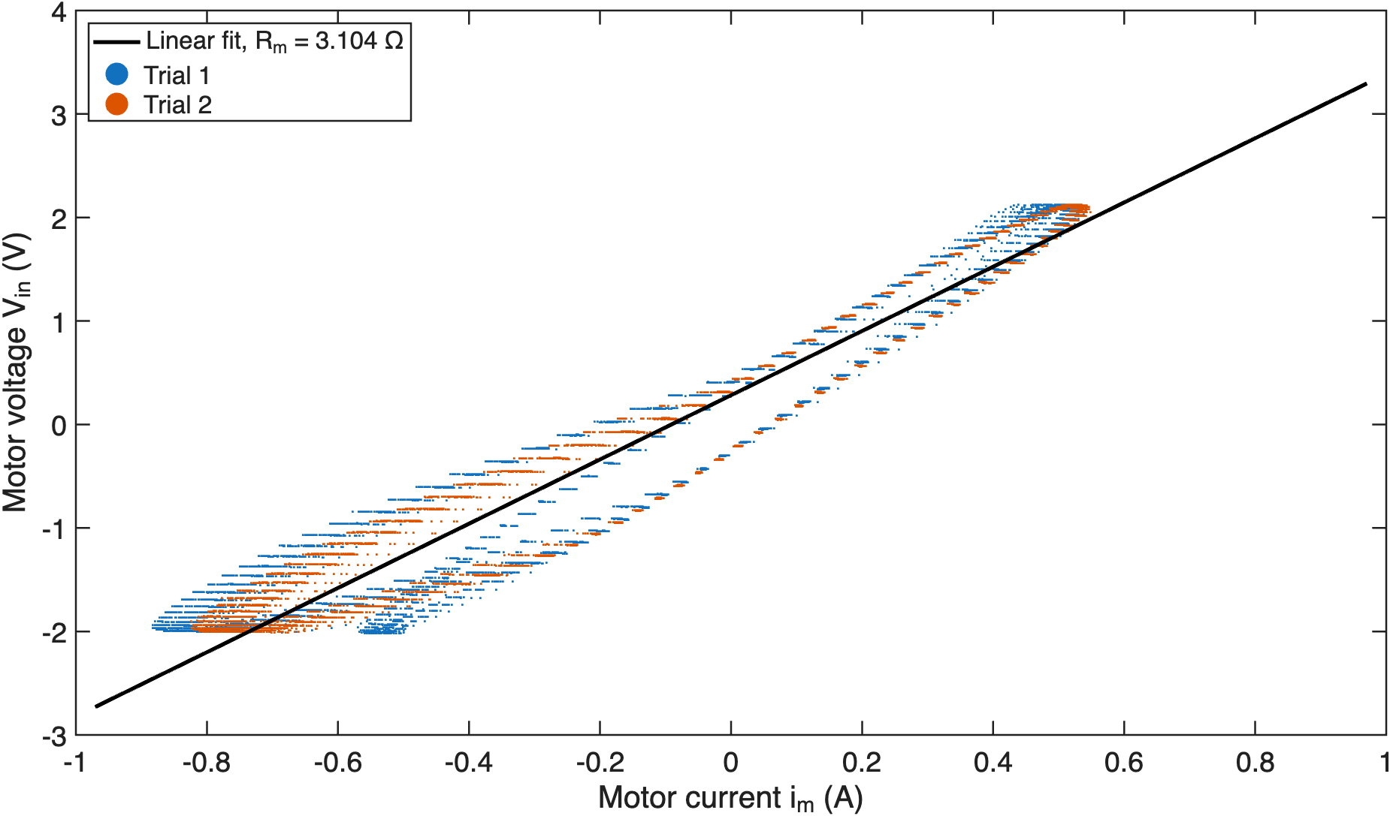
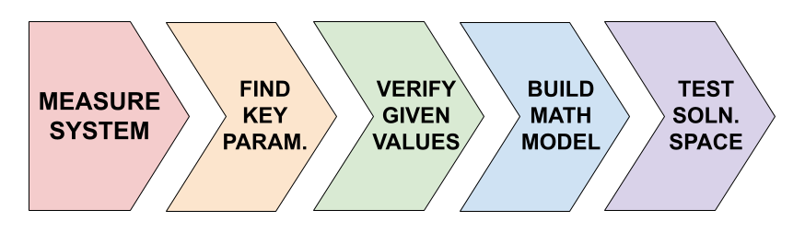
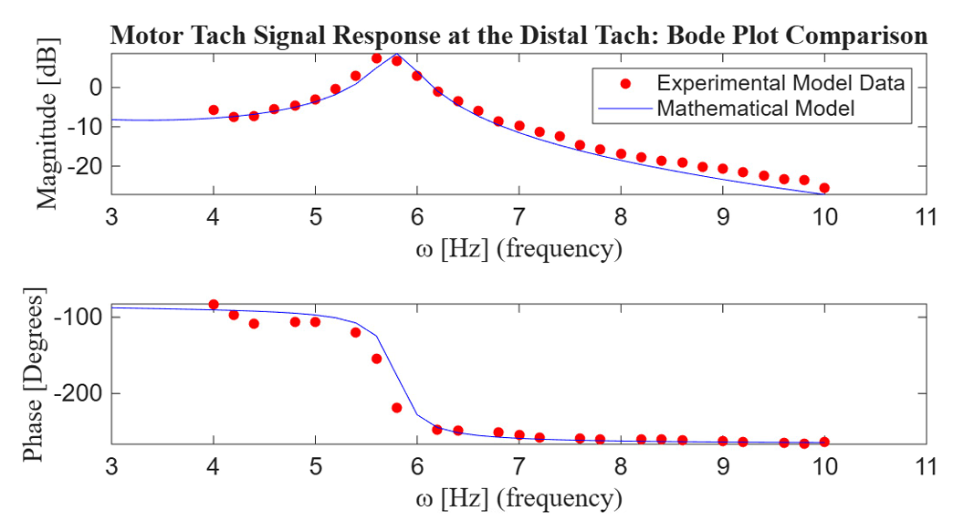
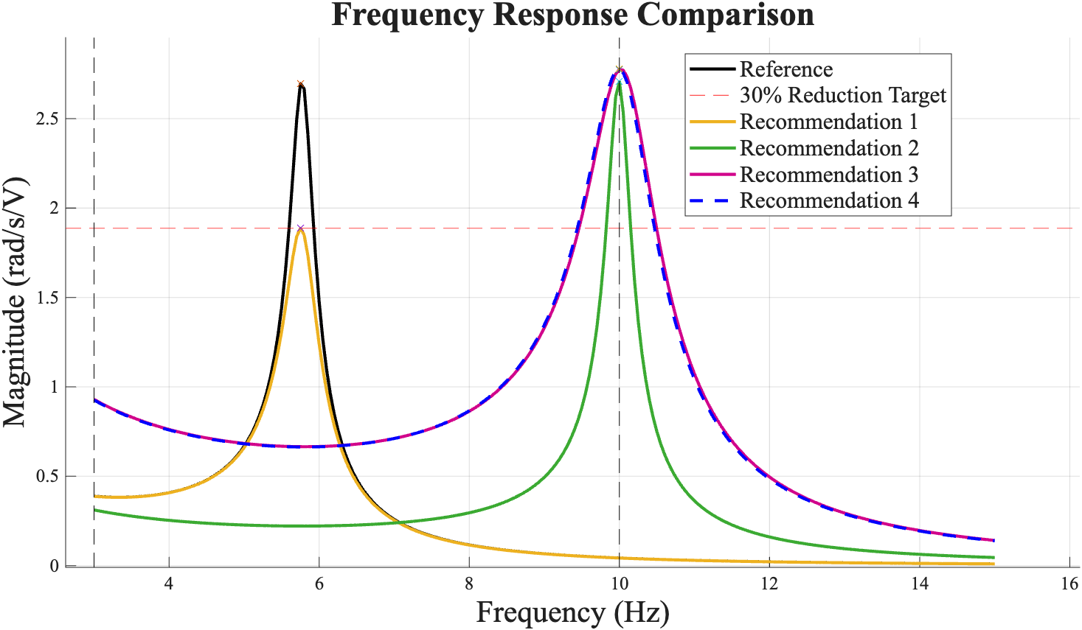
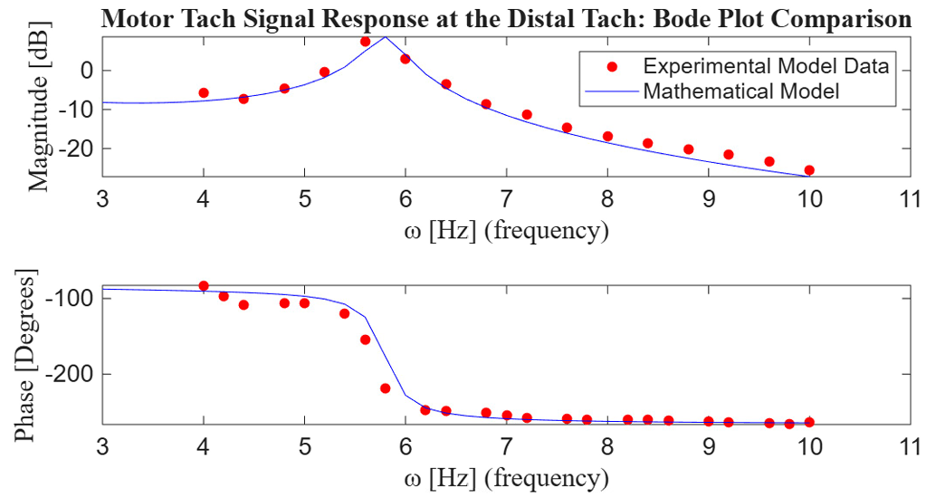
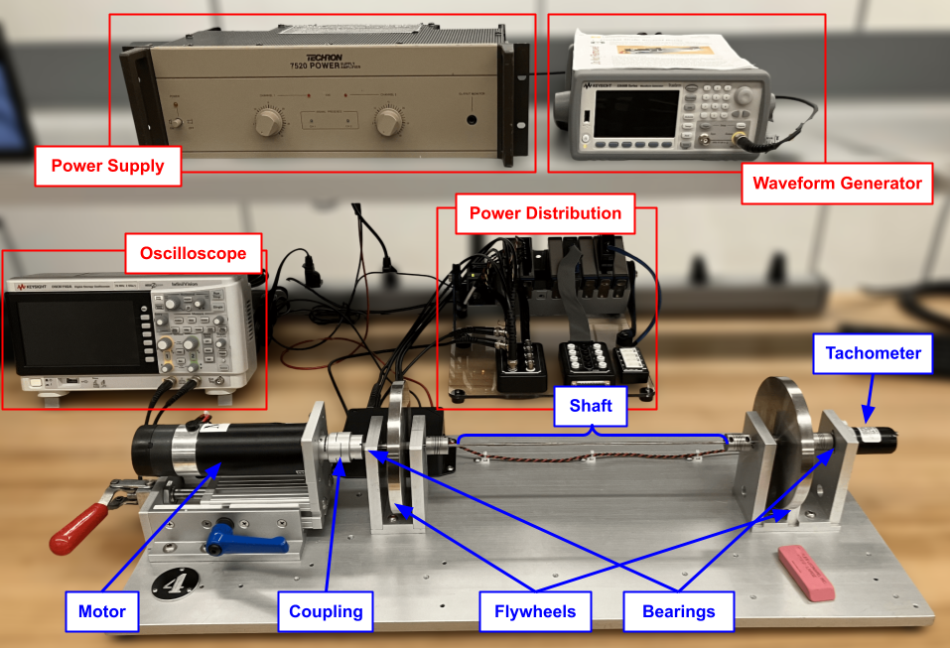
APPROACHES FOR DECREASING VIBRATIONS IN A MOTOR/DRIVE-AXLE MODEL
Arianna Contaldi, Michael Mancuso, Koda Mitsuhashi, Luisa Tambellini
Wolverine Dynamics, Inc. — MECHENG 450
INTRODUCTION
FINDING KEY PARAMETERS
ASSUMPTIONS & SIMPLIFICATIONS
Mesa Hybrid Vehicles Inc. has been recording significant vibrations in its new prototype hybrid-electric model drivetrain, which is believed to be caused by high flexibility in the axle. This undesirable vibration primarily occurs when the system’s motor is turned on or off, and Mesa seeks to reduce this vibration by at least 30%.
To find system friction, damping, or drive motor parameters, our team performed measurements on different configurations of the system, isolating the motor, flywheels, or letting the system spin freely, applying regression and best fit (fig 3).
In order to develop a math model of the system, our team was able to simplify complex behavior (?)
Viscous vs coloumbic damping; eraser jam is rigid; negligible inductance; rigid couplings; shaft inertia is ignored; steady state reached in tests;
mention error as well?
OBJECTIVES
Our team at Wolverine Dynamics, Inc. will investigate the source of these vibrations, and confirm whether the axle is the primary issue. After analyzing the current system, our team will construct an accurate model of it and test multiple design changes, presenting our best found set of solutions. (fig. 1)
Objectives:
Measure current system at a variety of inputs and in free response
Determine key parameters of system (friction/damping in bearings/motor)
Validate Mesa’s given given parameters (motor constant K_{m} and internal resistance R_{m}), calculate inertia of mechanical system (flywheels, shaft)
Create a mathematical model of the system and ensure it fits to experimental data. Determine which parameters affect system behavior the most.
Find a variety of possible parameter changes to reduce the vibration in the system by at least 30%.
FINDINGS
Figure 3 – Analysis for finding key parameters (expanded versions available in handout)
Analysis was conducted by altering our model parameters to visualize what effects would lead to a reduction in the systems’ vibrations. This testing led to the following conclusions:
1. Increase motor resistance by 113.2%
3. Decrease flywheel density by 67.5%
2. Increase shaft diameter by 31.5%
4. Decrease flywheel diameter by 24.4%
RESONANCE OF SYSTEM & FINAL MODEL
initial resonance frequency range
Figure 1 – Wolverine Dynamics design process
OVERVIEW OF EXPERIMENTAL SETUP
The experimental setup (Fig. 2) features mainly a DC motor driving a flywheel which then twists the flexible shaft against a second flywheel. Recorded in LabView at 2kHz:
Input voltage V_{in} (and assoc. frequency, RMS)
Current i_{m} (and assoc. frequency, RMS)
Angular speed of both flywheels θ̇₁ and θ̇₂
Figure 4 - Analysis of alternate system dimensions’ effect on vibrations
Figure 4 – Experimental Data (red) and Developed Model (blue) of System at Various Input Frequencies
RECOMMENDATIONS
After sweeping a range of sinusoidal current/voltage inputs, the resonant frequency of the entire system was found to be somewhere between 5 and 7 Hz. The magnitude of the peak (around 5.7Hz) was found to be around X dB, meaning our solution space needs to peak somewhere below X dB (Figure X).
Figure X compares the bode plots recorded from the experimental data and found mathematical transfer function relationship of the system using the validated K_{m}, R_{m}, and the damping coefficient of the motor, shaft and bearings from analysing the system response
Our recommendation to decrease
Figure 2 – Labeled Diagram of the Experimental Setup

Slide 2
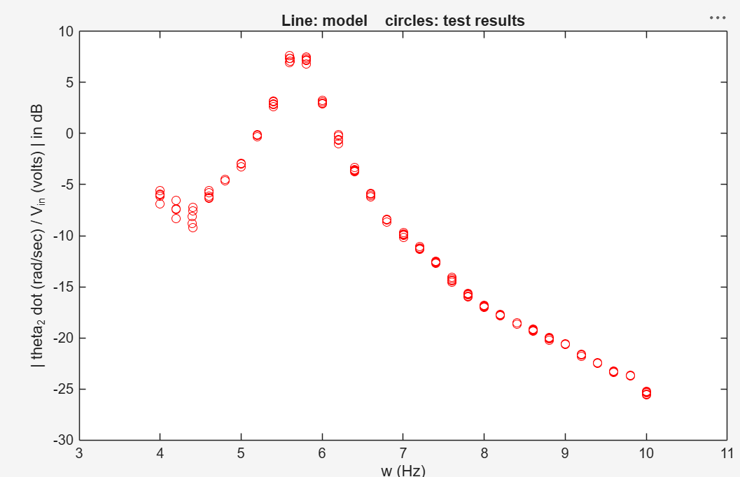
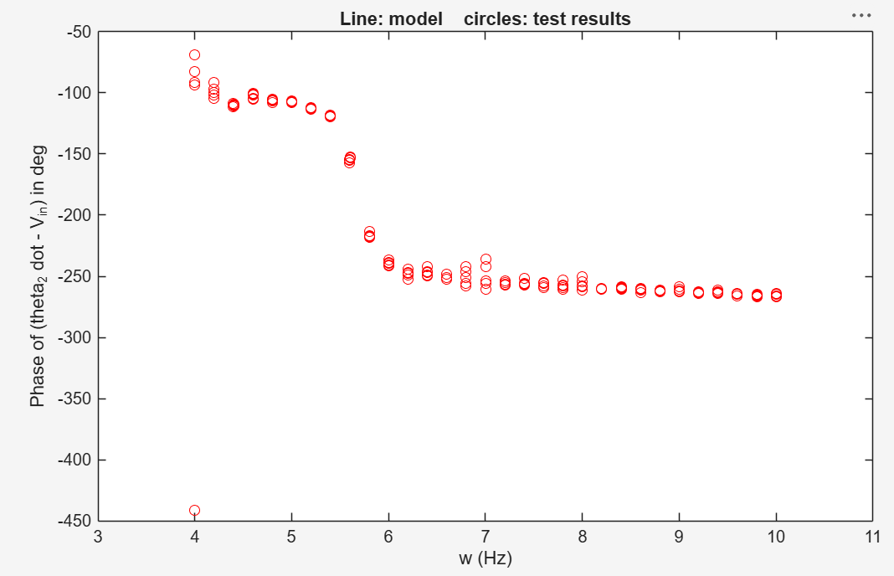
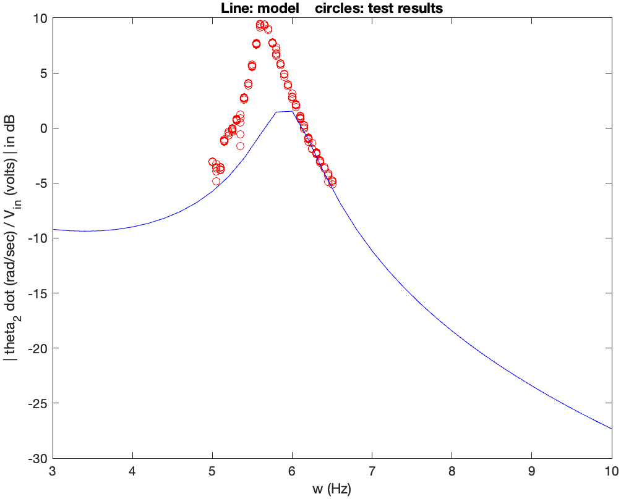
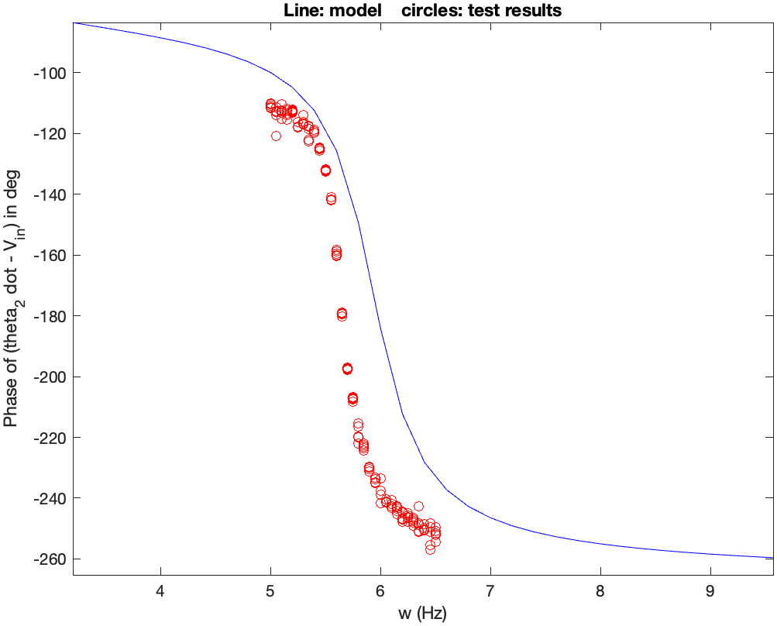
EXTRA GRAPHS:

